Slide 1
Generative Adversarial Network
GANs
Dr Milan Joshi

Slide 2
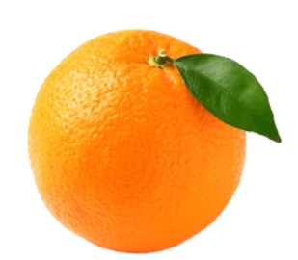
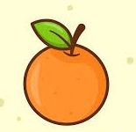
Test
Orange

Slide 3
What are GANS
GAN are deep neural net architectures comprised of two neural networks, competing one against the other (i.e. why adversarial)

Slide 4
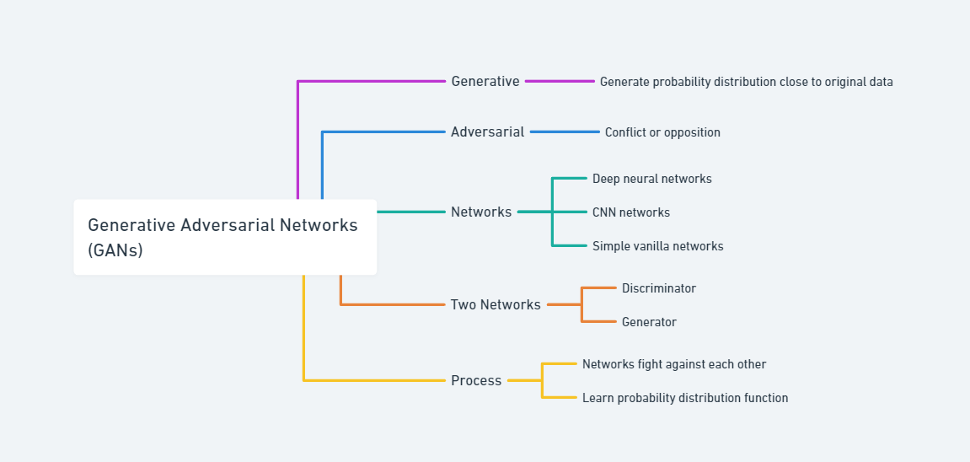
Generative Adversarial Network

Slide 5
Types of Models in Machine Learning
Important classes of Models
Discriminative-D
Generative-G
Classify whether a face is fake or not, you use a discriminative model which outputs 0 for a fake face and 1 for a real face, thus categorizing it as a classification problem.
The generator 𝐺 takes random noise 𝑧 (often sampled from a simple distribution like a Gaussian or uniform distribution) and transforms it into a fake image 𝐺(𝑧)).
The goal of the generator is to create images that are indistinguishable from real images

Slide 6
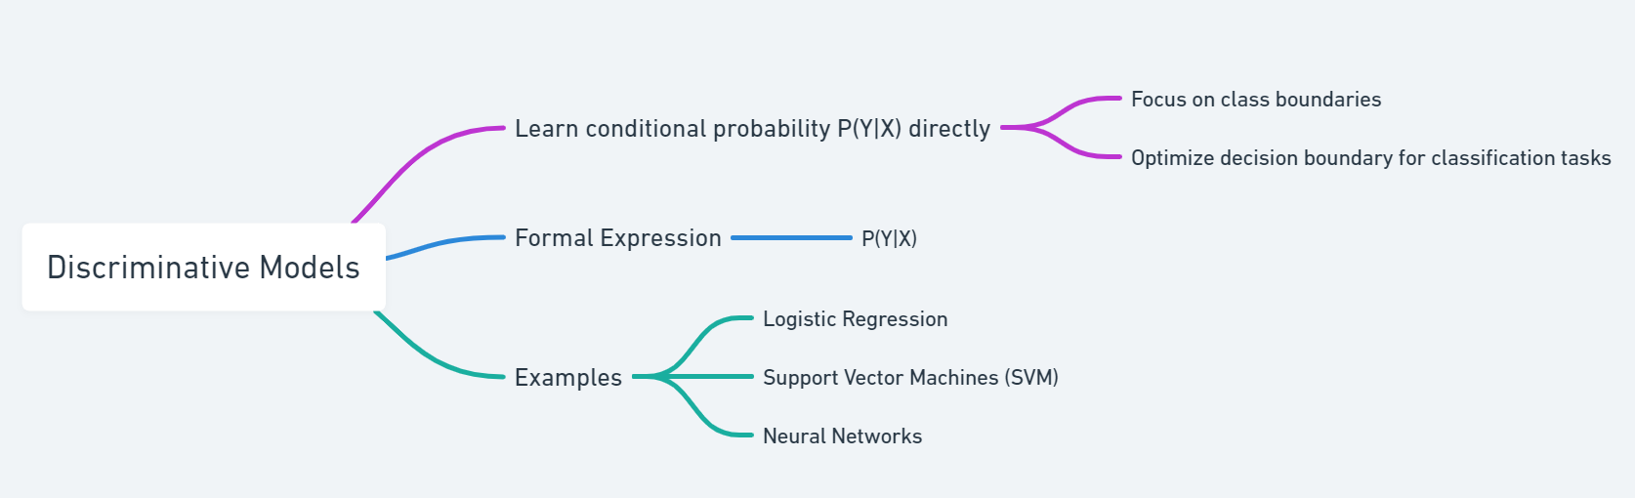

Slide 7
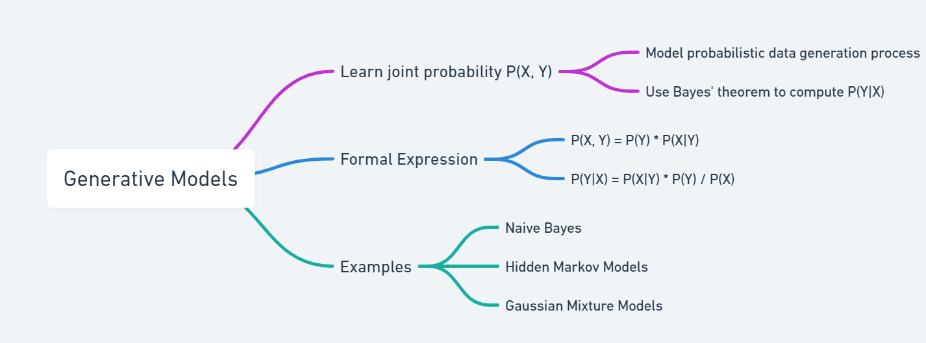

Slide 8
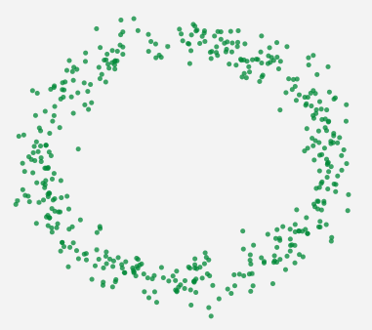
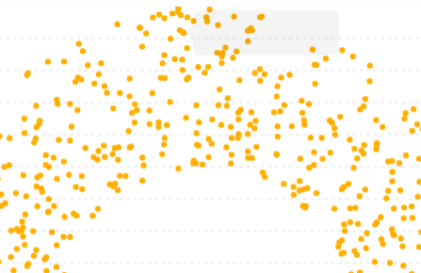
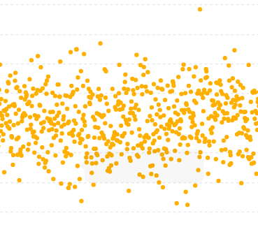
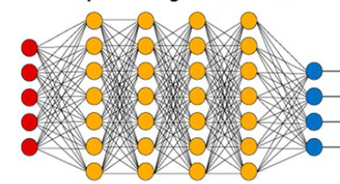
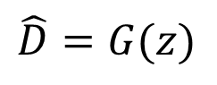
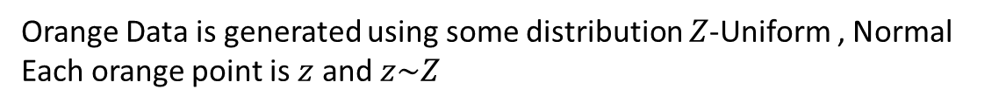
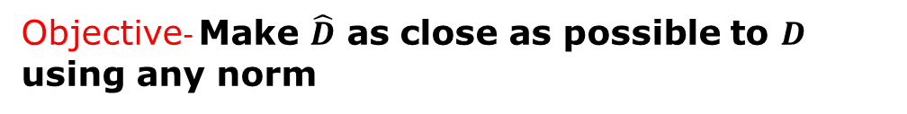
$X=$ set of all green points , $x$ is a single green Point $D$ is distribution of $X$ which is unknown
Objective- Make $\hat{D}$ as close as possible to $D$ using any norm
Orange Data is generated using some distribution $Z$-Uniform , Normal
Each orange point is $z$ and $z\sim Z$
$$\hat{D}=G(z)$$
Generator-G
Deep neural network
MLP CNN or any

Slide 9
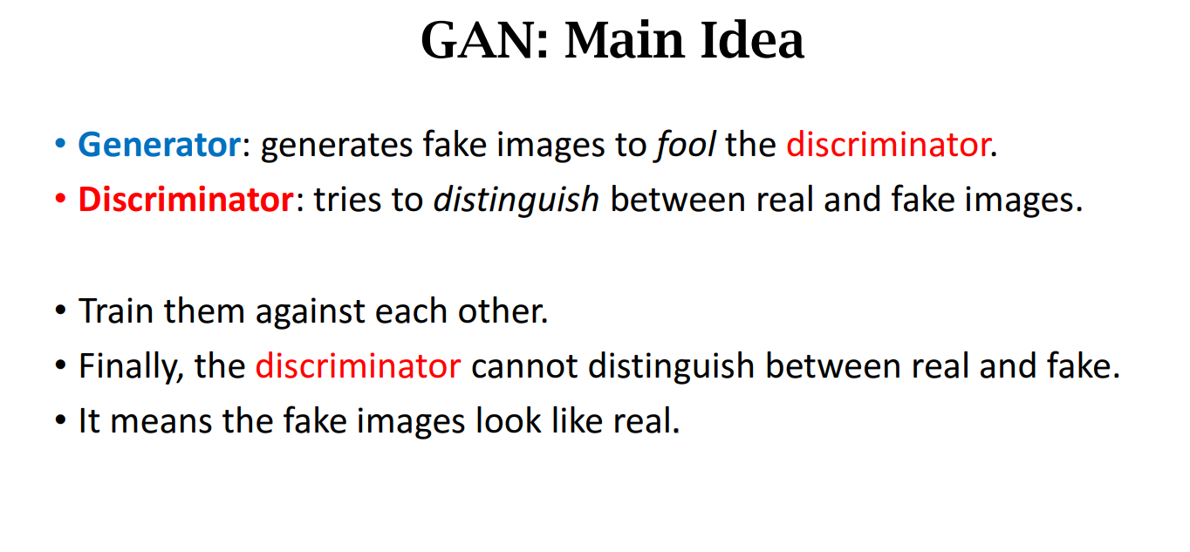

Slide 10
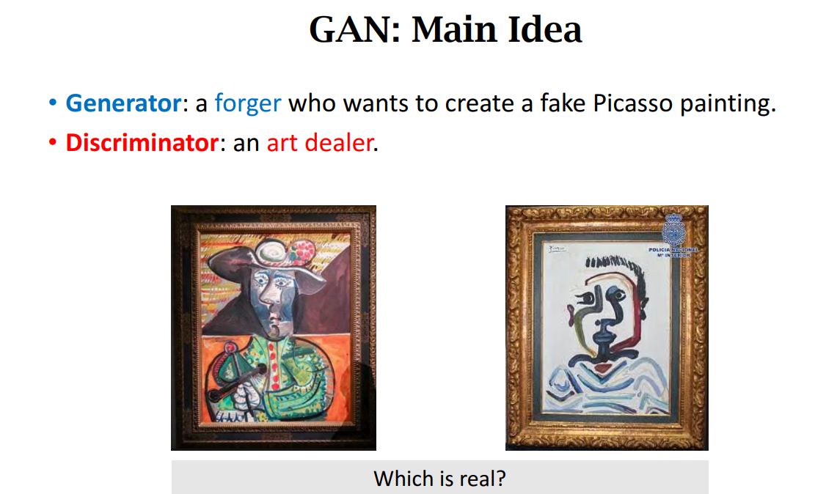

Slide 11
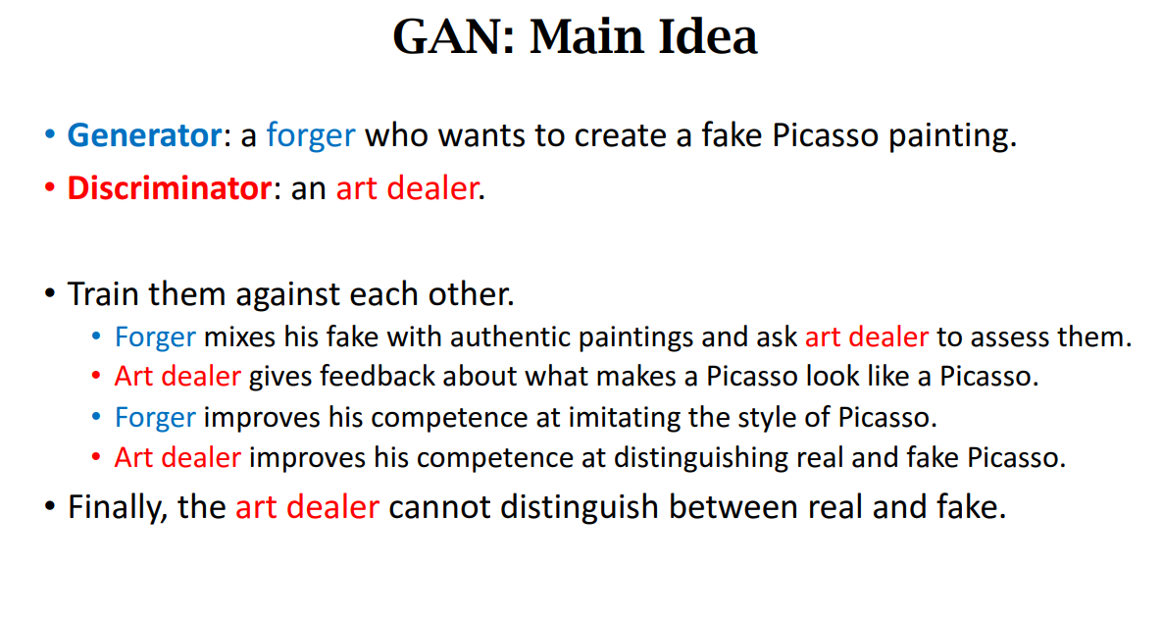

Slide 12
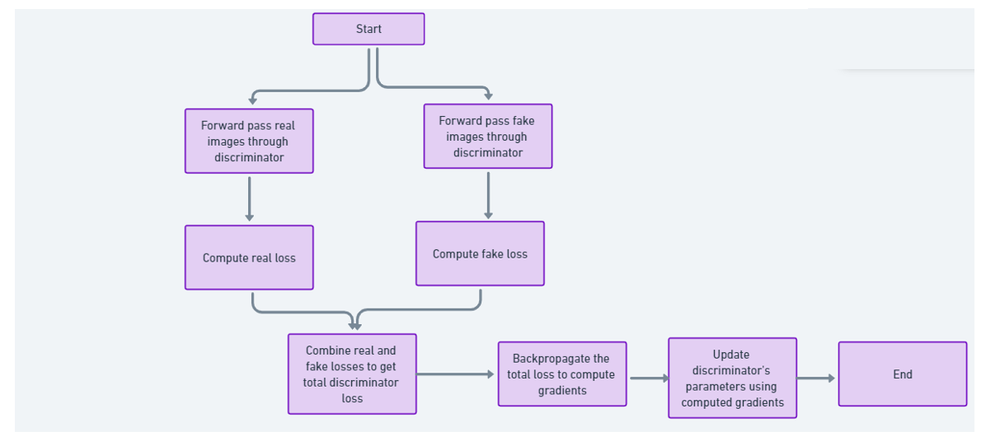
Training Discriminator

Slide 13
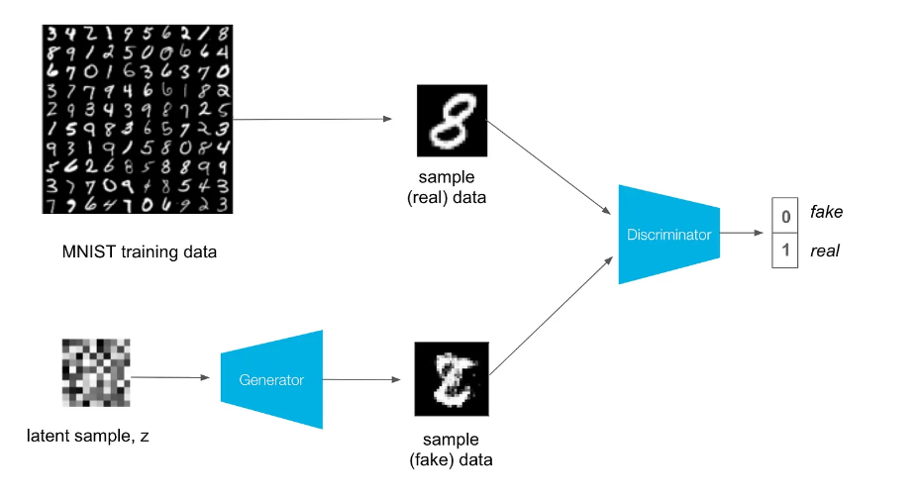

Slide 14
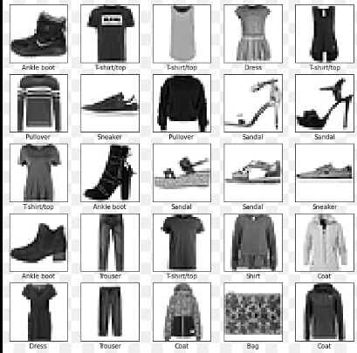
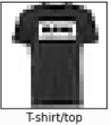
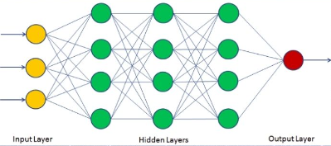
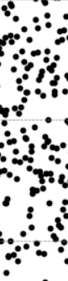
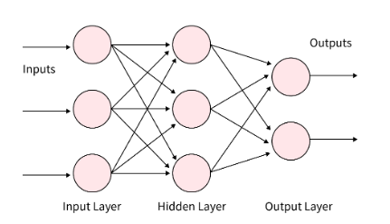
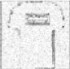
Real Sample –label y=1
Discriminator-D
Generator-G
Fake Sample –label y=0

Slide 15
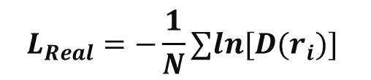
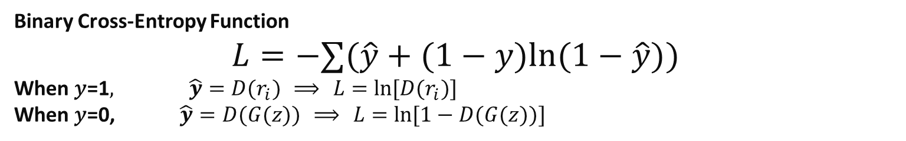
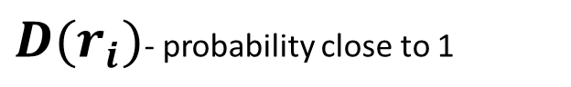
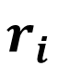
Forward Pass for Real Images
Input Real Images: Pass the batch of real images $\{r_{1},r_{2},r_{3}\}$ with label {1,1,1} through the discriminator. Randomly initialize weights $θ_{D}$ of discriminator , sigmoid at output layer
${D(r}_{i})$- probability close to 1
$$L_{Real}=−\frac{1}{N}∑ln⁡[D(r_{i})]$$
$$r_{i}$$
2. Compute Real Predictions: The discriminator outputs a probability for each real image indicating how likely it is to be real.$D(\{r_{1},r_{2},r_{3}\})=\{D(r_{1}),D(r_{2}),D(r_{3})\}$
3. Real Loss Calculation: Compute the loss for the real images using the binary cross-entropy loss. Since these are real images, the target labels are 1.
Binary Cross-Entropy Function
$$L=−∑(\hat{y}+(1−y)ln⁡(1−\hat{y}))$$
When 𝑦=1$, \hat{y}=D(r_{i}) ⟹ L=ln⁡[D(r_{i})]$
When 𝑦=0, $\hat{y}=D(G(z)) ⟹ L=ln⁡[1−D(G(z))]$

Slide 16
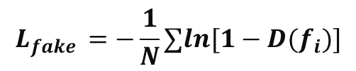
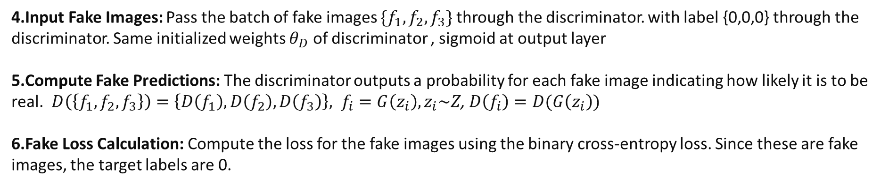
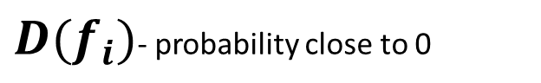
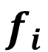
Forward Pass for Fake Images
Input Fake Images: Pass the batch of fake images $\{f_{1},f_{2},f_{3}\}$through the discriminator. with label {0,0,0} through the discriminator. Same initialized weights $θ_{D}$ of discriminator , sigmoid at output layer
Compute Fake Predictions: The discriminator outputs a probability for each fake image indicating how likely it is to be real. $D\left(\left\{f_{1},f_{2},f_{3}\right\}\right)=\left\{D\left(f_{1}\right),D\left(f_{2}\right),D\left(f_{3}\right)\right\}, f_{i}=G\left(z_{i}\right), z_{i}\sim Z$, $D\left(f_{i}\right)=D(G\left(z_{i}\right))$
Fake Loss Calculation: Compute the loss for the fake images using the binary cross-entropy loss. Since these are fake images, the target labels are 0.
$$L_{fake}=−\frac{1}{N}ln∑\left[1−D\left(f_{i}\right)\right]=−\frac{1}{N}ln∑\left[1−D\left(G(z_{i}\right)\right]$$
$$f_{i}$$
${D(f}_{i})$- probability close to 0
$$L_{fake }=−\frac{1}{N}∑ln⁡[1−D(f_{i})]$$

Slide 17
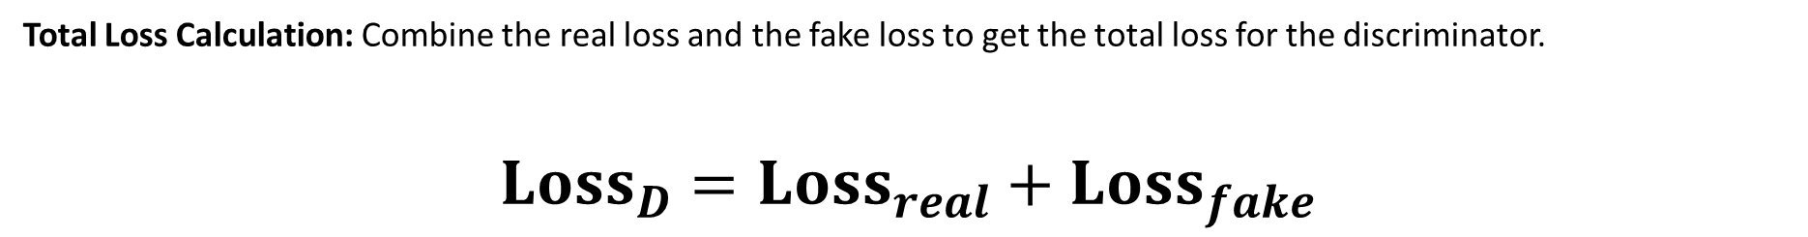
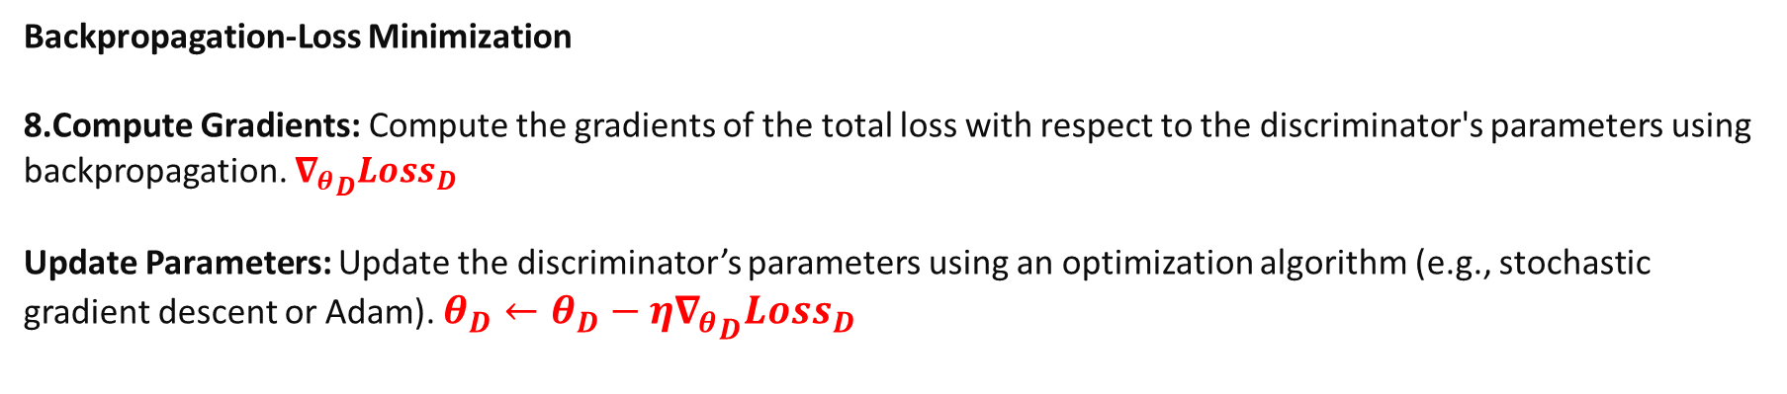
Total Discriminator Loss
Total Loss Calculation: Combine the real loss and the fake loss to get the total loss for the discriminator.
$${Loss}_{D}={Loss}_{real}+{Loss}_{fake}$$
${Loss}_{D}$ = $−\frac{1}{N}∑{log\left[D\left(r_{i}\right)\right]}−\frac{1}{N}∑ln⁡[1−D(f_{i})]$
Backpropagation-Loss Minimization
Compute Gradients: Compute the gradients of the total loss with respect to the discriminator's parameters using backpropagation. ${∇_{θ}}_{D}Loss_{D}$
Update Parameters: Update the discriminator’s parameters using an optimization algorithm (e.g., stochastic gradient descent or Adam). $θ_{D}←θ_{D}−η{∇_{θ}}_{D}Loss_{D}​$

Slide 18
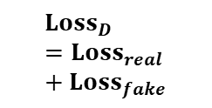

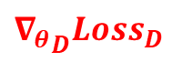
(Real Sample) –label y=1
Discriminator-D
$${Loss}_{D}={Loss}_{real}+{Loss}_{fake}$$
Generator-G
(Fake Sample ) –label y=0
$${∇_{θ}}_{D}Loss_{D}$$
$$θ_{D}←θ_{D}−η{∇_{θ}}_{D}Loss_{D}​$$

Slide 19
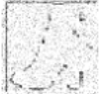
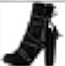
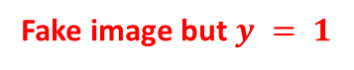
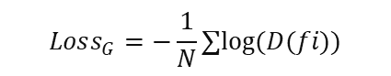
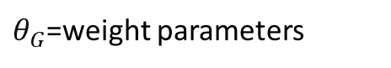
Training the Generator
$θ_{G}$=weight parameters
Fake image but $y = 1$
$$Loss_{G}=−\frac{1}{N}∑log⁡(D(fi​))$$
Freeze Discriminator Weights:
Before training the generator, we freeze the discriminator's weights to ensure they are not updated during the generator's training.
This can be done by setting the discriminator to evaluation mode or by ensuring that gradient updates do not apply to its parameters.

Slide 20
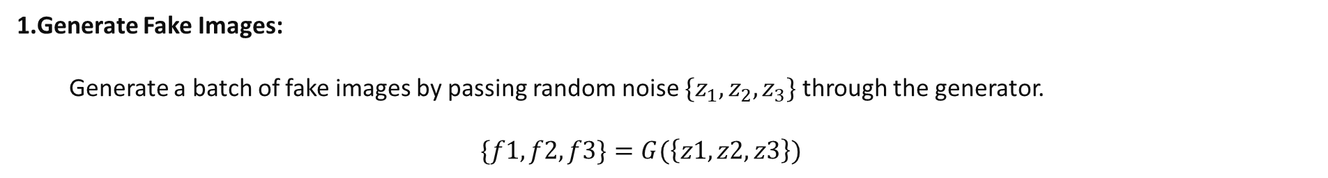
Training the Generator
Fake image but $y = 1$
$$Loss_{G}=−\frac{1}{N}∑log⁡(D(fi​))$$
Generate Fake Images:
Generate a batch of fake images by passing random noise $\{z_{1},z_{2},z_{3}\}$through the generator.
$$\{f1,f2,f3\}=G(\left\{z1,z2,z3\right\})$$

Slide 21
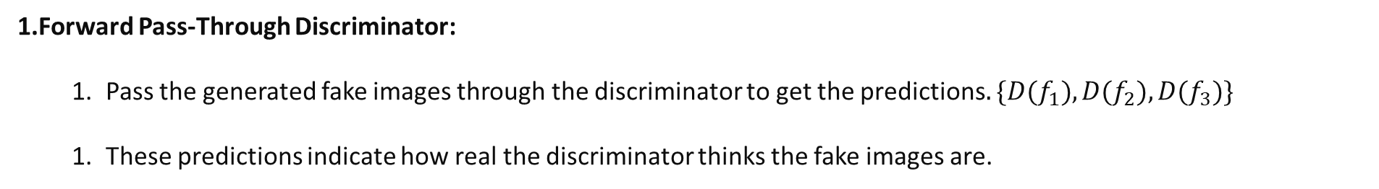
Training the Generator
Fake image but $y = 1$
$$Loss_{G}=−\frac{1}{N}∑log⁡(D(fi​))$$
Forward Pass-Through Discriminator:
Pass the generated fake images through the discriminator to get the predictions$.\{D(f_{1}),D(f_{2}),D(f_{3})\}$
These predictions indicate how real the discriminator thinks the fake images are.

Slide 22
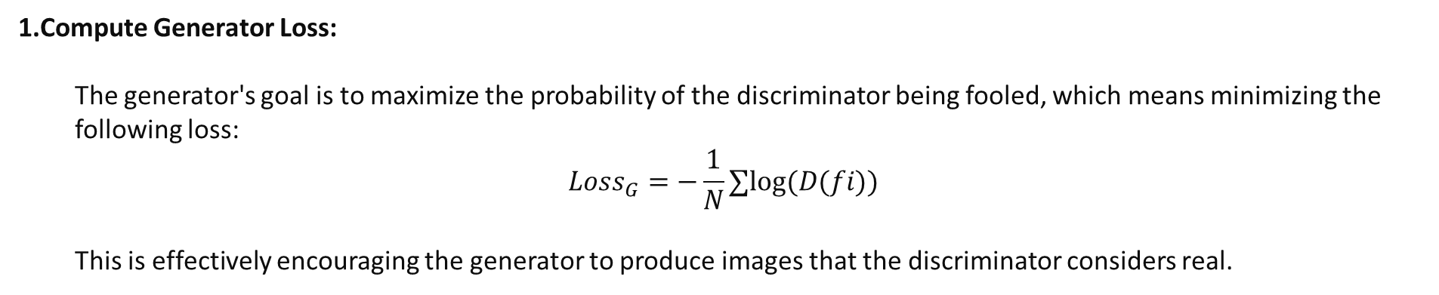
Training the Generator
Fake image but $y = 1$
$$Loss_{G}=−\frac{1}{N}∑log⁡(D(fi​))$$
Compute Generator Loss:
The generator's goal is to maximize the probability of the discriminator being fooled, which means minimizing the following loss:
$$Loss_{G}=−\frac{1}{N}∑log⁡(D(fi​))$$
This is effectively encouraging the generator to produce images that the discriminator considers real.

Slide 23
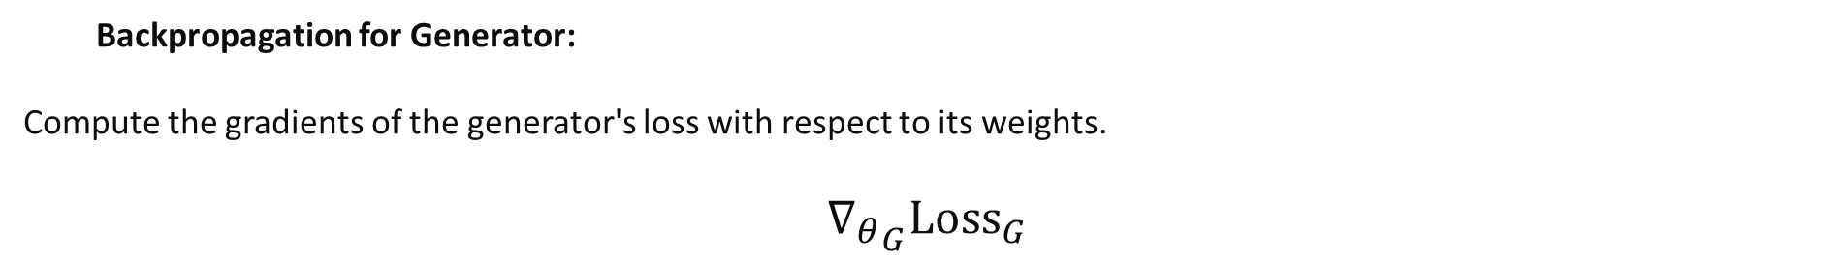
Training the Generator
Fake image but $y = 1$
$$Loss_{G}=−\frac{1}{N}∑log⁡(D(fi​))$$
Backpropagation for Generator:
Compute the gradients of the generator's loss with respect to its weights.
$${∇_{θ}}_{G}{Loss}_{G}$$

Slide 24
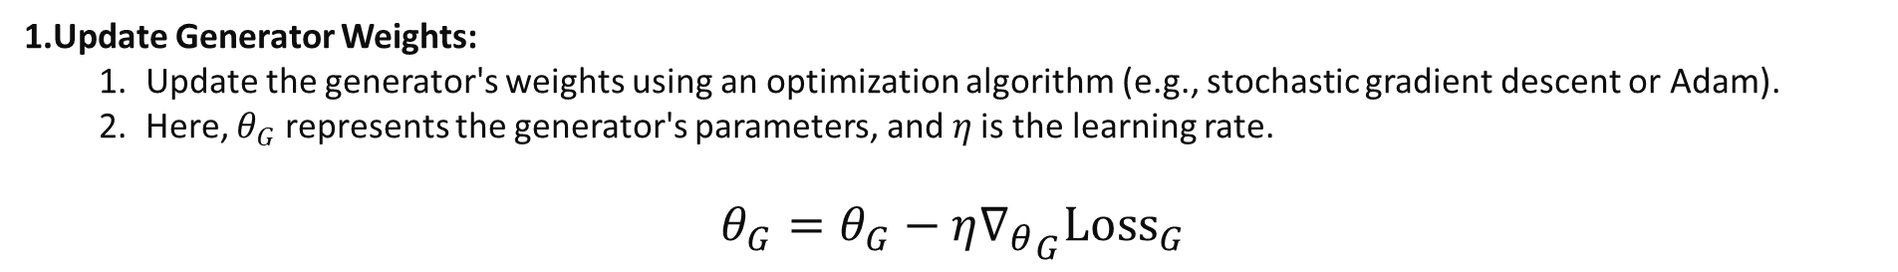
Training the Generator
Fake image but $y = 1$
$$Loss_{G}=−\frac{1}{N}∑log⁡(D(fi​))$$
Update Generator Weights:
Update the generator's weights using an optimization algorithm (e.g., stochastic gradient descent or Adam).
Here, $θ_{G}$ represents the generator's parameters, and 𝜂 is the learning rate.
$$θ_{G}=θ_{G}−{η∇_{θ}}_{G}{Loss}_{G}$$

Slide 25
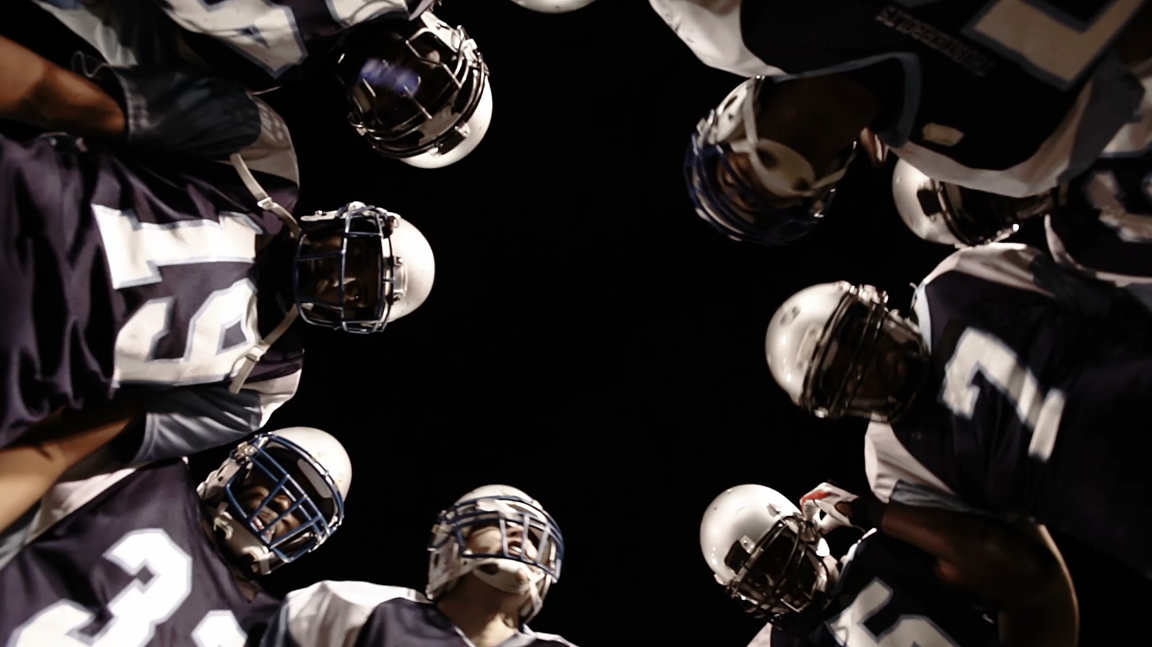
GAN As Min-Max Game

Slide 26
Basic Idea of GANs
Generator G
Discriminator D
This network generates fake data from random noise
This network tries to distinguish between real data (from the training dataset) and fake data (generated by G).
The two networks compete in a game:
The generator tries to create data that looks real to fool the discriminator.
The discriminator tries to correctly identify whether the data is real or fake.

Slide 27
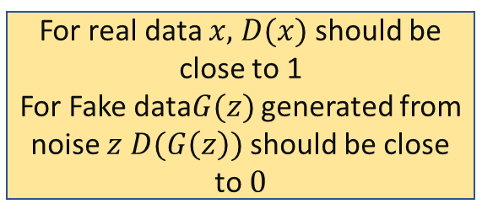
Basic Idea of GANs
Objective-Discriminator D maximize the probability of correctly classifying real and fake data.
Objective of the Generator (G): wants to minimize the probability that the discriminator correctly identifies its output as fake.
For real data $x,$ $D(x)$ should be close to 1
For Fake data$G(z)$ generated from noise $z$ $D(G\left(z\right))$ should be close to $0$
It aims to make 𝐷(𝐺(𝑧)) close to 1.
Minimax Game Objective:
The discriminator tries to maximize a value function 𝑉(𝐷,𝐺)
The generator tries to minimize the same value function 𝑉(𝐷,𝐺)

Slide 28
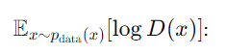
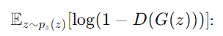
Value Function
The value function 𝑉(𝐷,𝐺) represents the objectives of both networks and is defined as follows:
This term represents the expectation (average) over all real data 𝑥x.
The discriminator wants to maximize this term because 𝐷(𝑥) should be high (close to 1) for real data.
This term represents the expectation (average) over all noise 𝑧.
The discriminator wants to maximize this term because 𝐷(𝐺(𝑧)) should be low (close to 0) for fake data.
The generator wants to minimize this term because it wants 𝐷(𝐺(𝑧)) to be high (close to 1), making the fake data look real.

Slide 29
Minimax Game
The discriminator 𝐷 aims to maximize the value function 𝑉(𝐷,𝐺).
The generator 𝐺 aims to minimize the value function 𝑉(𝐷,𝐺).
Formally, the GAN training process is a minimax game defined as:

Slide 30
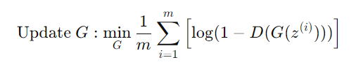





Steps to Train a GAN
For each training iteration
Repeat the process until the generator produces high-quality data that fools the discriminator.
Train the Discriminator 𝐷:
Train the Generator 𝐺:
Sample a batch of real data $\{x^{(i)}\}$from the real data distribution $p_{data}(x).$
Sample a batch of noise $\{z^{\left(i\right)}\}$from the noise distribution $p_{z}(z).$
Generate fake data $\{G(z^{\left(i\right)})\}$using the generator.
Update the discriminator by maximizing the value function 𝑉(𝐷,𝐺)
Sample a batch of noise $\{z^{\left(i\right)}\}$ from the noise distribution $p_{z}(z).$
Generate fake data $\{G(z^{\left(i\right)})\}$using the generator.
Update the generator by minimizing the value function 𝑉(𝐷,𝐺)
Initialize the generator 𝐺 and discriminator 𝐷 with random weights
Alternatively, for better gradients, maximize $log⁡D(G(z))$

Slide 31
Why conditional GAN
MNIST Digits
Task: Generating images of specific digits from the MNIST dataset.
In a standard GAN, you can generate images of handwritten digits, but you have no control over which digit is generated. By using a Conditional GAN, you can specify which digit you want to generate.
Increased Control: cGANs allow for more precise control over the output, making it possible to generate images with specific characteristics or belonging to specific classes.
Improved Quality: By conditioning on additional information, the generator can produce higher quality and more relevant images, as the model has more context about what to generate.
Broader Applications: The ability to condition the generation process expands the range of potential applications, making cGANs suitable for various tasks that require specific outputs based on given inputs.

Slide 32







Conditional GAN- Discriminator
Input Real Images: Pass the batch of real images $\{r_{1},r_{2},r_{3}\}$ with class label {$c_{1},c_{2},c_{3}$} and labels {1,1,1}through the discriminator. Randomly initialize weights $θ_{D}$ of discriminator , sigmoid at output layer. Pass the concatenated real images and condition labels through the discriminator
$$L_{Real}=−\frac{1}{N}∑ln⁡[D(r_{i},c_{i})]$$
$${(r}_{i,}c_{i})$$
${D(r}_{i},c_{i})$- probability close to 1
$${D(r}_{i},c_{i})=D(r_{i}|c_{i})\sim p(real|r_{i},c_{i})$$
2. Input Fake Images: Pass the batch of fake images $\{f_{1},f_{2},f_{3}\}$through the discriminator with same class label $\{c_{1},c_{2},c_{3}\}$. with label {0,0,0} through the discriminator. Same initialized weights $θ_{D}$ of discriminator , sigmoid at output layer. Pass the concatenated fake images and condition labels through the discriminator
${D(f}_{i,}c_{i})$- probability close to 0
$$L_{fake }=−\frac{1}{N}∑ln⁡[1−D(f_{i},c_{i})]$$
$${(f}_{i,}c_{i})$$

Slide 33
(Real Sample, t-shirt) –label y=1
Discriminator-D
Generator-G
(Fake Sample , t-shirt) –label y=0
t-shirt

Slide 34
Total Discriminator Loss
Total Loss Calculation: Combine the real loss and the fake loss to get the total loss for the discriminator.
$${Loss}_{D}={Loss}_{real}+{Loss}_{fake}$$
${Loss}_{D}$ = $−\frac{1}{N}\sum{ln}\left[D\left(r_{i},c_{i}\right)\right]−\frac{1}{N}∑ln⁡[1−D({(f}_{i,}c_{i}))]$
Backpropagation-Loss Minimization
Compute Gradients: Compute the gradients of the total loss with respect to the discriminator's parameters using backpropagation. ${∇_{θ}}_{D}Loss_{D}$
Update Parameters: Update the discriminator’s parameters using an optimization algorithm (e.g., stochastic gradient descent or Adam). $θ_{D}←θ_{D}−η{∇_{θ}}_{D}Loss_{D}​$

Slide 35
(Real Sample, t-shirt) –label y=1
Discriminator-D
$${Loss}_{D}={Loss}_{real}+{Loss}_{fake}$$
Generator-G
(Fake Sample , t-shirt) –label y=0
$${∇_{θ}}_{D}Loss_{D}$$
$$θ_{D}←θ_{D}−η{∇_{θ}}_{D}Loss_{D}​$$
t-shirt

Slide 36
Summary
Concatenate each real and fake image with its condition label.
Forward Pass Real Images through the discriminator and compute the real loss.
Forward Pass Fake Images through the discriminator and compute the fake loss.
Combine the real and fake losses to get the total discriminator loss.
Backpropagate the total loss to compute the gradients.
Update the discriminator’s parameters using the computed gradients.

Slide 37



Conditional GAN- Generator
Fake image $(f_{i},c_{i}$) but $y = 1$
$$Loss_{G}=−\frac{1}{N}∑log⁡(D(fi​,c_{i}))$$
Generate a batch of fake images by passing random noise $\{z_{1},z_{2},z_{3}\}$and their corresponding condition labels {𝑐1,𝑐2,𝑐3} through the generator$.\{f_{1},f_{2},f_{3}\}=G(\{z_{1},z_{2},z_{3}\},\{c_{1},c_{2},c_{3}\})$
Concatenate each fake image $f_{i}$ with its corresponding condition label $c_{i}.$

Slide 38



Conditional GAN- Generator
Fake image but $y = 1$
$$Loss_{G}=−\frac{1}{N}∑log⁡(D(fi​,c_{i}))$$
Backpropagation for Generator:
Compute the gradients of the generator's loss with respect to its weights.
$${∇_{θ}}_{G}{Loss}_{G}$$

Slide 39


Conditional GAN- Generator
Fake image $(f_{i},c_{i}$) but $y = 1$
$$Loss_{G}=−\frac{1}{N}∑log⁡(D(fi​,c_{i}))$$
Update the generator's weights using an optimization algorithm (e.g., stochastic gradient descent or Adam).
Here, $θ_{G}$ represents the generator's parameters, and 𝜂 is the learning rate.
$$θ_{G}=θ_{G}−{η∇_{θ}}_{G}{Loss}_{G}$$

Slide 40

Applications

Slide 41
Image Generation
Application: GANs are widely used to generate realistic images from random noise.
GAN Used: Standard GAN, DCGAN (Deep Convolutional GAN)
Process: The generator network creates images from random noise, and the discriminator evaluates their authenticity. Over time, the generator learns to produce highly realistic images.
Examples: Creating images of non-existent people, generating art, producing high-quality images from low-resolution inputs.
Face Generation: GANs like DCGAN can create realistic images of faces that do not exist. This is useful for generating avatars, entertainment, and even anonymizing real people's faces.
Art and Design: Artists and designers use GANs to create new artwork, textures, and patterns. GANs can generate unique and novel designs that inspire creativity.

Slide 42
Image-to-Image Translation:
Application: GANs can transform images from one domain to another.
GAN Used: Pix2Pix, CycleGAN
Process: The generator learns to map images from one domain (e.g., sketches) to another domain (e.g., photorealistic images). The discriminator ensures the generated images are indistinguishable from real images in the target domain.
Examples: Converting black and white images to color, transforming sketches into detailed images, translating day images to night images.
Pix2Pix: Translates paired images, such as edge maps to photographs or maps from satellite images.
CycleGAN: Translates between unpaired images, such as converting photos to paintings and vice versa.
Pix2Pix: A framework where input images are transformed into output images based on learned mappings. For example, translating edge maps to photographs or creating maps from satellite images.
CycleGAN: A framework that learns to translate between image domains without paired examples. This can be used to convert photos to paintings and vice versa.

Slide 43
Text-to-Image Synthesis
Application: GANs can generate images from textual descriptions.
GAN Used: StackGAN, AttnGAN
Process: The generator takes a textual description as input and produces an image that matches the description. The discriminator assesses whether the generated image aligns with the text and appears realistic.
Examples: Generating images from captions, creating artwork based on text descriptions, producing product images from descriptive text.
StackGAN: Uses a two-stage approach to generate high-resolution images from text.
AttnGAN: Utilizes an attention mechanism to focus on relevant words in the description while generating the image.
Applications in E-commerce: Generating product images based on textual descriptions can enhance the shopping experience by providing visual representations of products.
Scientific Visualization: Generating visual content from textual data descriptions, such as visualizing molecular structures from chemical descriptions.

Slide 44
Super-Resolution Imaging
Application: GANs enhance the resolution of low-quality images.
GAN Used: SRGAN (Super-Resolution GAN)
Process: The generator learns to produce high-resolution images from low-resolution inputs. The discriminator helps by distinguishing between real high-resolution images and generated ones.
Examples: Improving the quality of old photographs, enhancing medical imaging details, upscaling video game graphics.
Medical Imaging: Enhancing the resolution of MRI or CT scans can help doctors make more accurate diagnoses by providing clearer images.
Satellite Imaging: Improving the resolution of satellite images allows for better analysis and monitoring of geographical changes and urban development.

Slide 45
Data Augmentation
Application: GANs are used to augment training datasets, especially when data is scarce.
GAN Used: cGAN (Conditional GAN), ACGAN (Auxiliary Classifier GAN
Process: The generator creates new, realistic samples based on the existing data distribution. These new samples can be used to expand and diversify the training dataset.
Examples: Augmenting medical datasets with realistic patient images, expanding datasets for facial recognition systems, generating synthetic data for machine learning models in autonomous driving.
cGAN: Generates data conditioned on labels, making it useful for augmenting labeled datasets.
ACGAN: Generates data with additional class labels, improving the variety and quality of synthetic samples.
Healthcare: Generating synthetic medical images to augment datasets, helping to train more robust diagnostic models.
Autonomous Driving: Creating synthetic images of various driving conditions, traffic scenarios, and environments to train autonomous vehicles.

Slide 46
Different GANS
Image Generation: Standard GAN, DCGAN for creating realistic images from random noise.
Image-to-Image Translation: Pix2Pix, CycleGAN for transforming images across different domains.
Text-to-Image Synthesis: StackGAN, AttnGAN for generating images from textual descriptions.
Super-Resolution Imaging: SRGAN for enhancing the resolution of low-quality images.
Data Augmentation: cGAN, ACGAN for augmenting training datasets with realistic synthetic samples.

Slide 47

https://github.com/hindupuravinash/the-gan-zoo
https://github.com/nashory/gans-awesome-applications
https://github.com/zhangqianhui/AdversarialNetsPapers
https://www.deeplearningbook.org/contents/generative_models.html

Slide 48

Applications of Image Generation
Synthetic Dataset Creation
For training DL models
Source: https://arxiv.org/pdf/1612.07828.pdf

Slide 49


Applications of Image Generation
Synthetic Dataset Creation
For training DL models
Image Editing
Reconstruct Variations
Source: https://arxiv.org/pdf/1611.06355.pdf
Source: https://github.com/hezhangsprinter/ID-CGAN

Slide 50

Applications of Image Generation
Synthetic Dataset Creation
For training DL models
Image Editing
Reconstruct Variations
Cyber Security
Detecting forgery

Slide 51
Applications of Image Generation
Synthetic Dataset Creation
Image Editing
Cyber Security (adversarial training)

Slide 52
Applications of Image Generation
Synthetic Dataset Creation
For training DL models
Image Editing
Reconstruct Variations
Cyber Security
Addressing adversarial attacks

Slide 53

Deep Learning Architecture of GANs

Slide 54
Formal Training Methodology of GANs

Slide 55
Formal Training Methodology of GANs
Step 1: Deﬁne architecture of Discriminator

Slide 56
Formal Training Methodology of GANs
Step 1: Deﬁne architecture of Discriminator
Step 2: Deﬁne architecture of Generator

Slide 57
Formal Training Methodology of GANs
Step 1: Deﬁne architecture of Discriminator
Step 2: Deﬁne architecture of Generator
Step 3: Train Discriminator

Slide 58
Formal Training Methodology of GANs
Step 1: Deﬁne architecture of Discriminator
Step 2: Deﬁne architecture of Generator
Step 3: Train Discriminator
Step 3.1: Take samples from real data

Slide 59
Formal Training Methodology of GANs
Step 1: Deﬁne architecture of Discriminator
Step 2: Deﬁne architecture of Generator
Step 3: Train Discriminator
Step 3.1: Take samples from real data
Step 3.2: Generate fake data from Generator

Slide 60
Formal Training Methodology of GANs
Step 1: Deﬁne architecture of Discriminator
Step 2: Deﬁne architecture of Generator
Step 3: Train Discriminator
Step 3.1: Take samples from real data
Step 3.2: Generate fake data from Generator
Step 3.3: Update the parameters of Discriminator on the combined batch

Slide 61
Formal Training Methodology of GANs
Step 1: Deﬁne architecture of Discriminator
Step 2: Deﬁne architecture of Generator
Step 3: Train Discriminator (for one or more iterations)
Step 3.1: Take samples from real data
Step 3.2: Generate fake data from Generator
Step 3.3: Update the parameters of Discriminator on the combined batch

Slide 62
Formal Training Methodology of GANs
Step 1: Deﬁne architecture of Discriminator
Step 2: Deﬁne architecture of Generator
Step 3: Train Discriminator (for one or more iterations)
Step 3.1: Take samples from real data
Step 3.2: Generate fake data from Generator
Step 3.3: Update the parameters of Discriminator on the combined batch
Step 4: Train generator

Slide 63
Formal Training Methodology of GANs
Step 1: Deﬁne architecture of Discriminator
Step 2: Deﬁne architecture of Generator
Step 3: Train Discriminator (for one or more iterations)
Step 3.1: Take samples from real data
Step 3.2: Generate fake data from Generator
Step 3.3: Update the parameters of Discriminator on the combined batch
Step 4: Train generator
Step 4.1: Generate fake data from Generator

Slide 64
Formal Training Methodology of GANs
Step 1: Deﬁne architecture of Discriminator
Step 2: Deﬁne architecture of Generator
Step 3: Train Discriminator (for one or more iterations)
Step 3.1: Take samples from real data
Step 3.2: Generate fake data from Generator
Step 3.3: Update the parameters of Discriminator on the combined batch
Step 4: Train generator
Step 4.1: Generate fake data from Generator
Step 4.2: Update the parameters of Generator on how well the Discriminator is fooled

Slide 65
Formal Training Methodology of GANs
Step 1: Deﬁne architecture of Discriminator
Step 2: Deﬁne architecture of Generator
Step 3: Train Discriminator (for one or more iterations)
Step 3.1: Take samples from real data
Step 3.2: Generate fake data from Generator
Step 3.3: Update the parameters of Discriminator on the combined batch
Step 4: Train generator
Step 4.1: Generate fake data from Generator
Step 4.2: Update the parameters of Generator on how well the Discriminator is fooled
Step 5: (Optional) Check if the fake data visually if it seems legit. If yes, stop training, else go to Step 3

